Slide 1
project/
├images/ # crawled images
├static
│ └ classified_images/ # classified images will save
│ └ dog, cat folder
├ image_consumer.py # Kafka Consumer + classification + save DB
├ flask_app.py # Flask webserver
├ templates/
│ └ gallery.html # result hompage

Slide 2
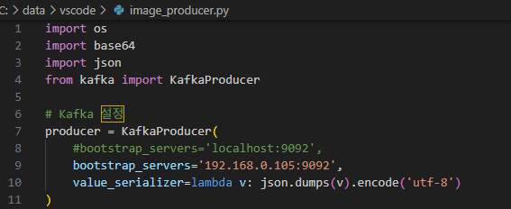
Run docker desktop
Run Zookeeper
Bash:
--- insert powershell
docker run -d --name zookeeper -p 2181:2181 zookeeper
--- done
Create Wurstmeister/Kafka container
--please use this code
-- when Kafa + zookeeper haver same docker network.
Bash:
--- insert powershell
docker run -d --name kafka -p 9092:9092 -e KAFKA_ZOOKEEPER_CONNECT=zookeeper:2181 -e KAFKA_ADVERTISED_LISTENERS=PLAINTEXT://192.168.219.100:9092 -e KAFKA_LISTENERS=PLAINTEXT://0.0.0.0:9092 -e KAFKA_LISTENER_SECURITY_PROTOCOL_MAP=PLAINTEXT:PLAINTEXT --link zookeeper wurstmeister/kafka
--- done
192.168.219.100 should be your ip
Also, change image_producer.py – bootstrap_servers

Slide 3
Create MariaDB
Bash:
Busan : docker container name. Docker ps [name] = busan
--- insert powershell
docker run -p 3306:3306 --detach --name vault -e MARIADB_USER=bigdata -e MARIADB_PASSWORD=bigdata+ -e MARIADB_DATABASE=webscrap -e MARIADB_ROOT_PASSWORD=bigdata+ mariadb:latest
--- done
: docker container’s name : vault.
Bash: docker ps
-zookeeper / mariadb / kafka should run..
docker run -p 3306:3306 --detach --name vault -e MARIADB_USER=bigdata - e MARIADB_PASSWORD=bigdata+ -e MARIADB_DATABASE=webscrap -e MARIADB_ROOT_PASSWORD=bigdata+ mariadb:latest

Slide 4
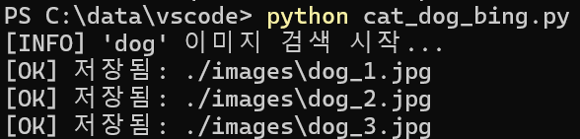
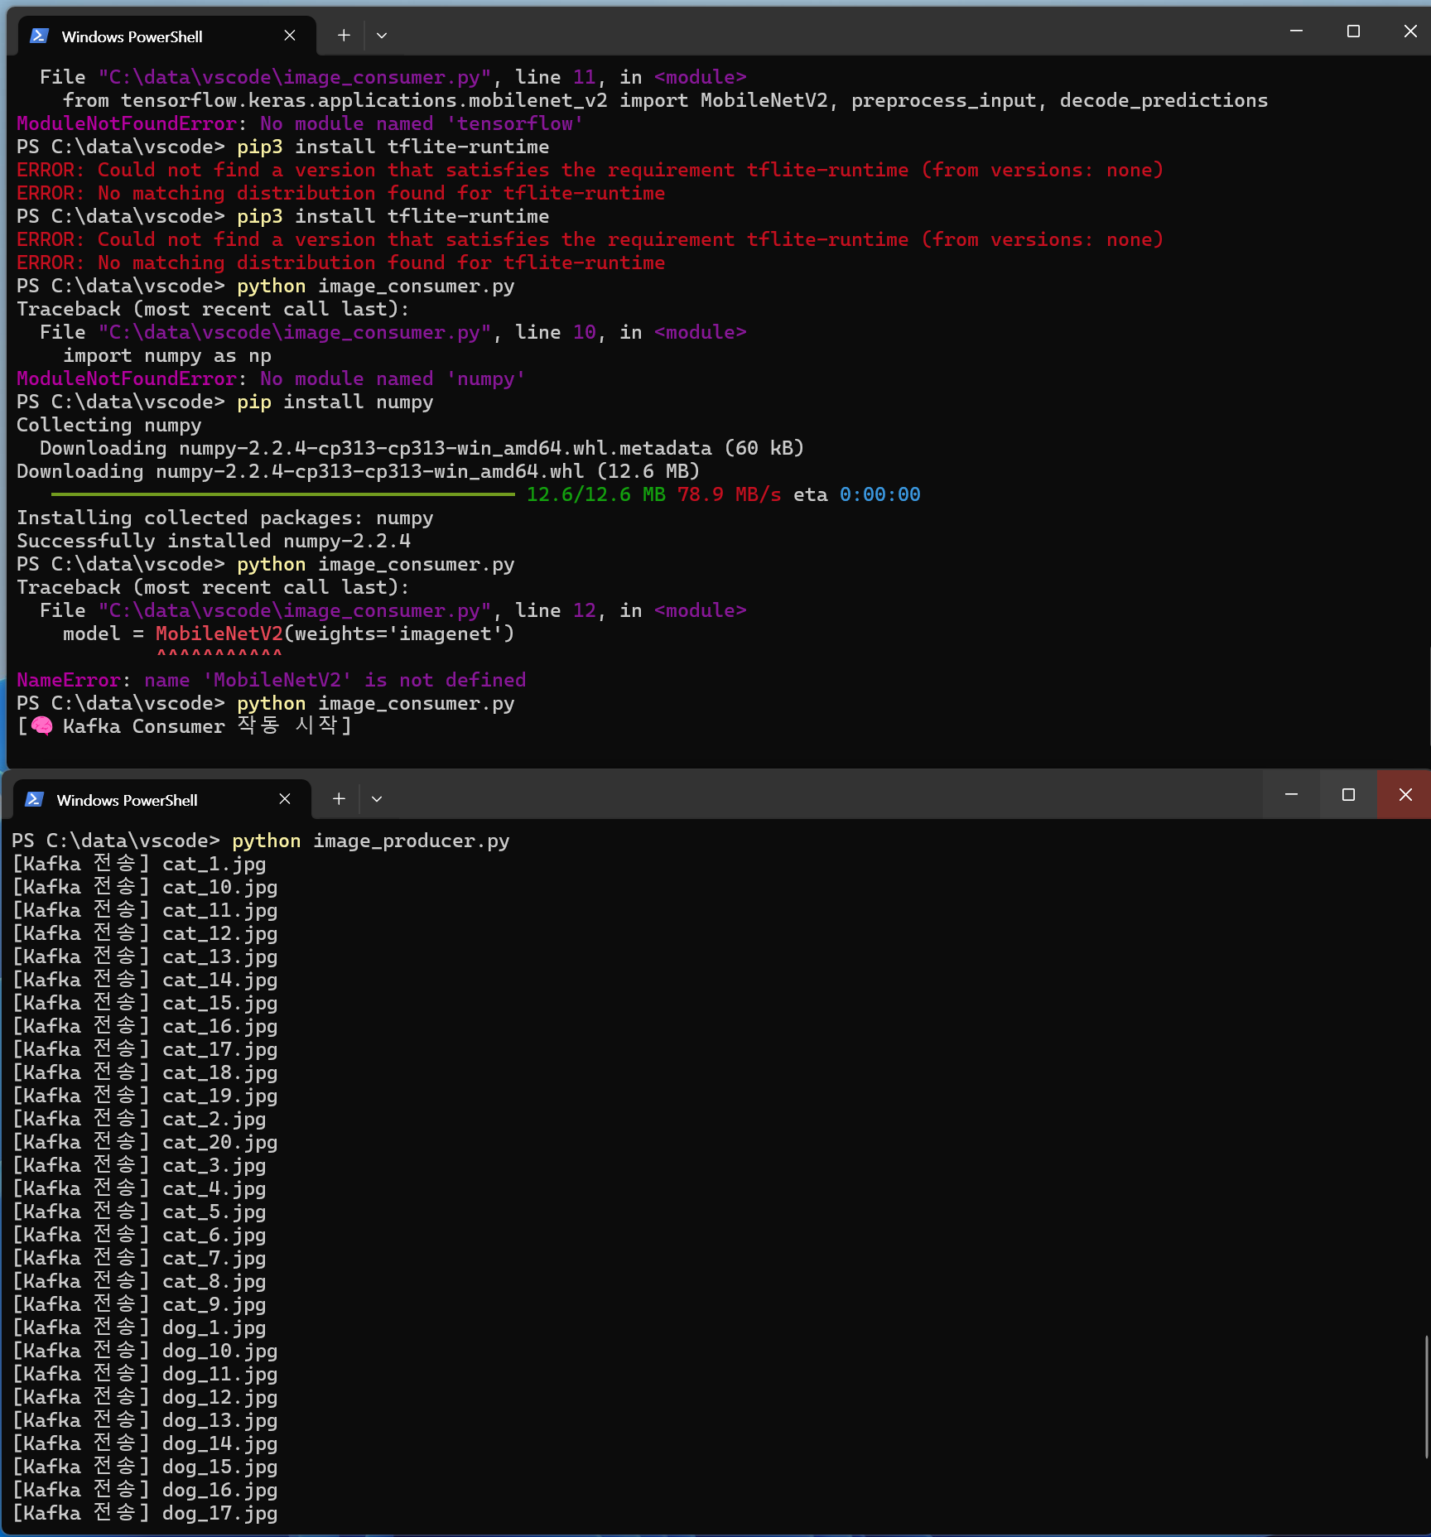

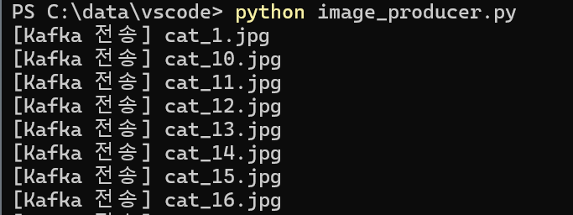
pip install requests pillow beautifulsoup4 kafka-python pymysql numpy flask
And then,
Bash:
> python cat_dog_bing.py
> python image_consumer.py
Run other windows powershell
> python image_producer.py
> python flask_app.py
‘dog’ 이미지 검색 시작.. – search ‘dog’ image..
저장됨 means saved
[Kafka consumer 작동시작] = kafka consumer run
When run image_producer.py
Kafka 전송 = kafka transmit

Slide 5
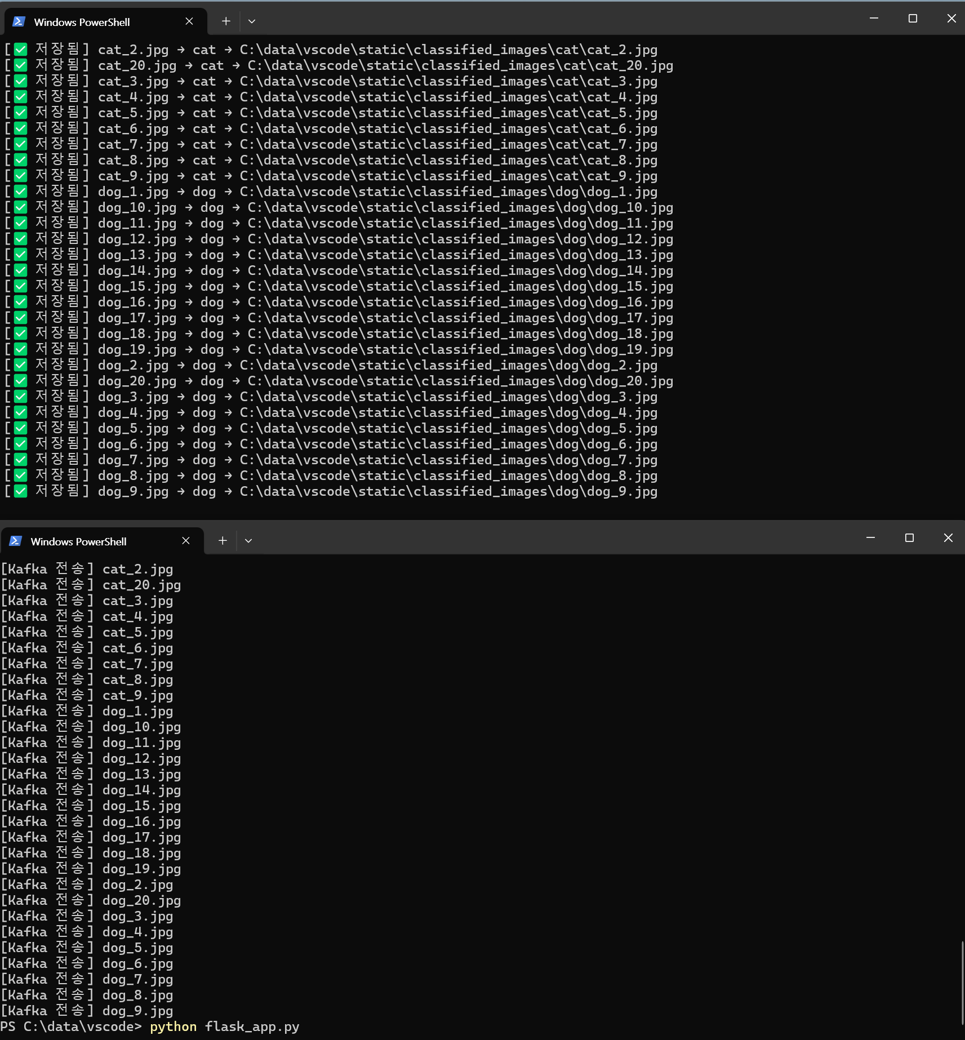
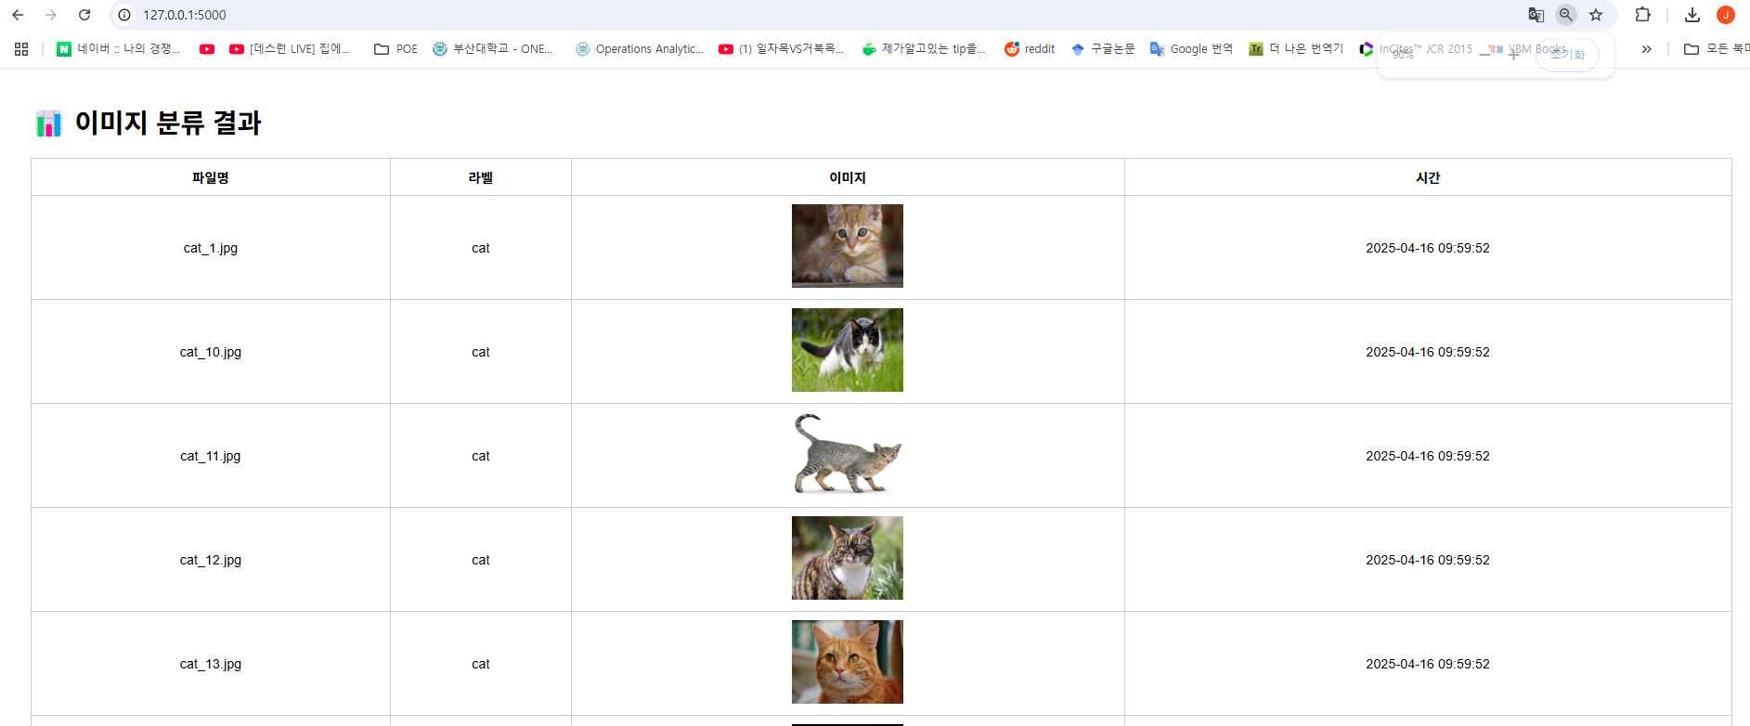
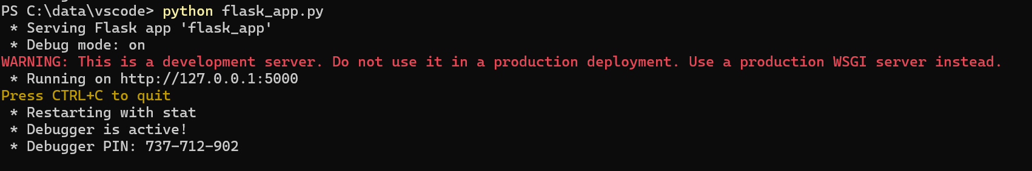
Python image_consumer.py
http://127.0.0.1:5000/
Python image_producer.py
And
>pyhon flask_app.py

Slide 6
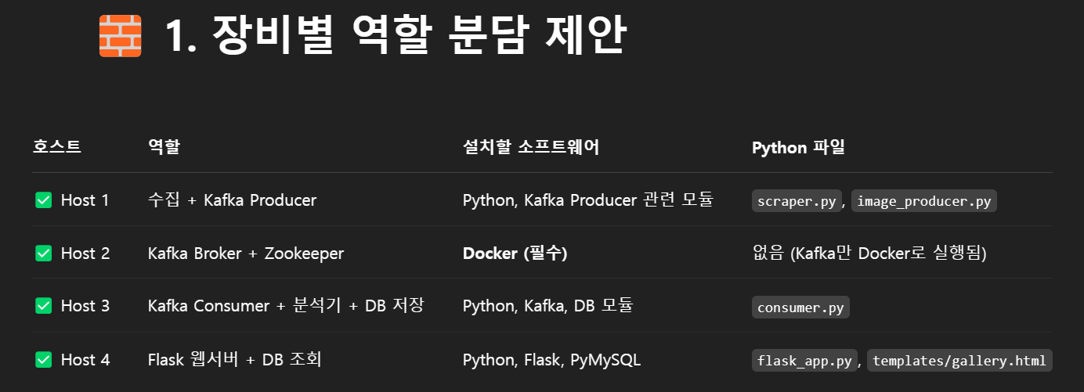

Slide 7
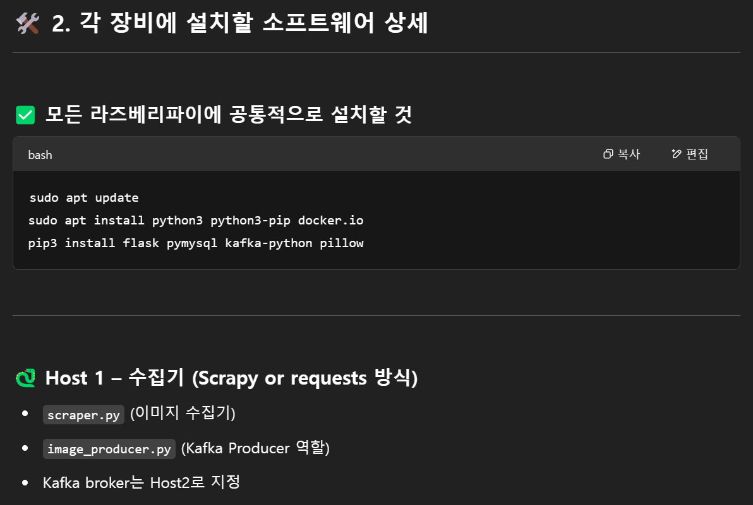
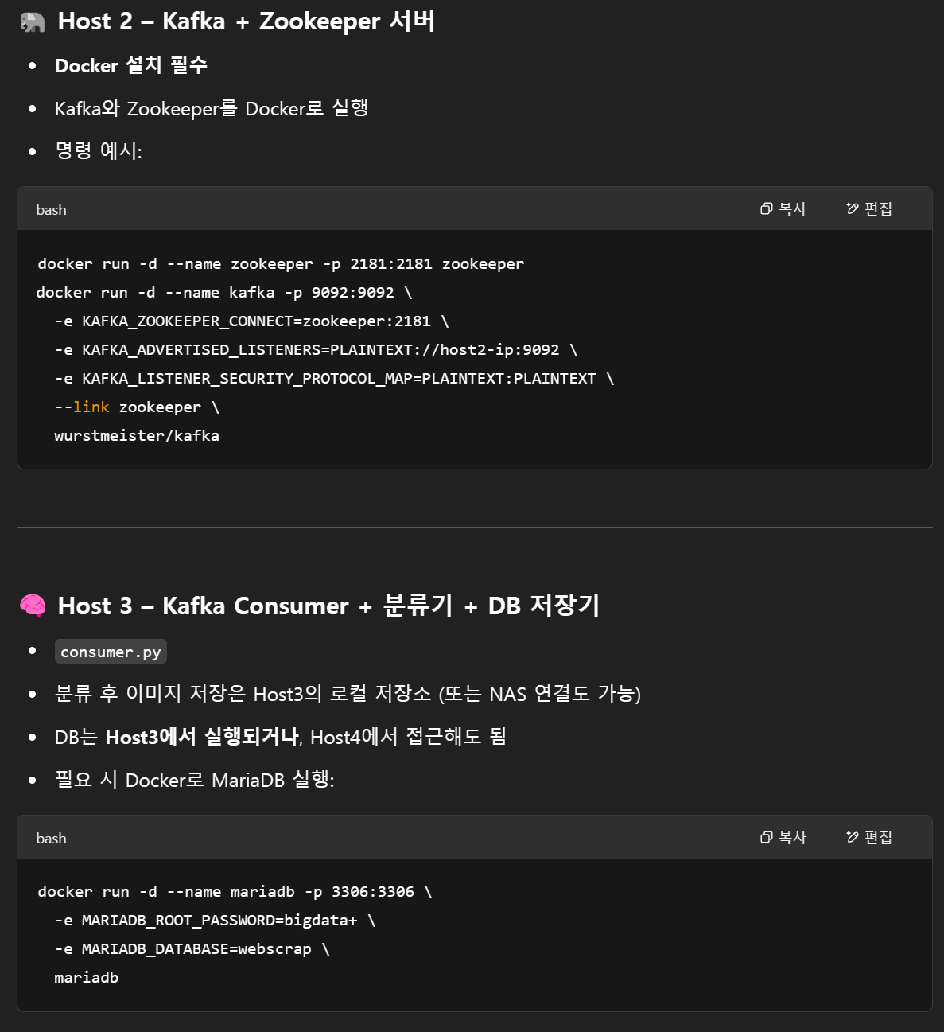
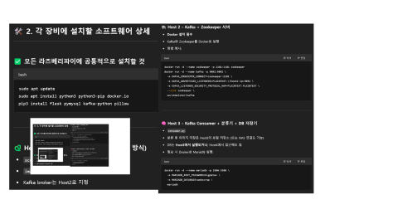

Slide 8
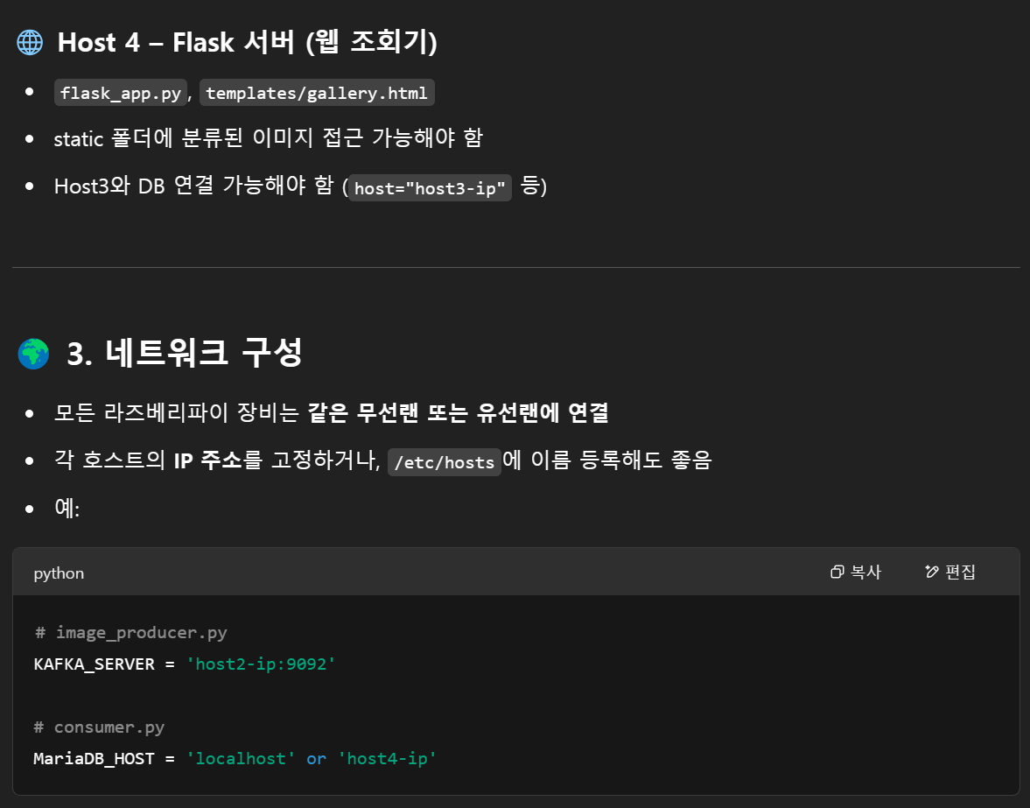
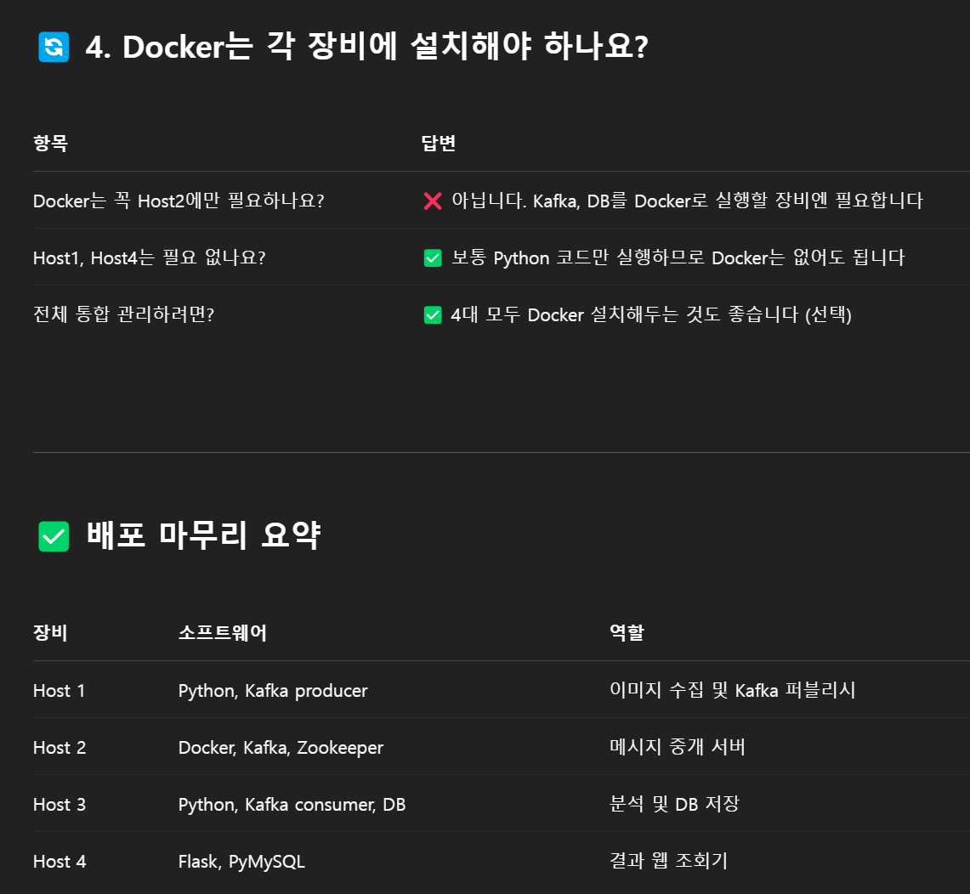

Slide 9
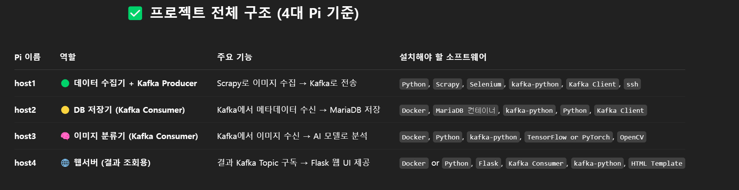
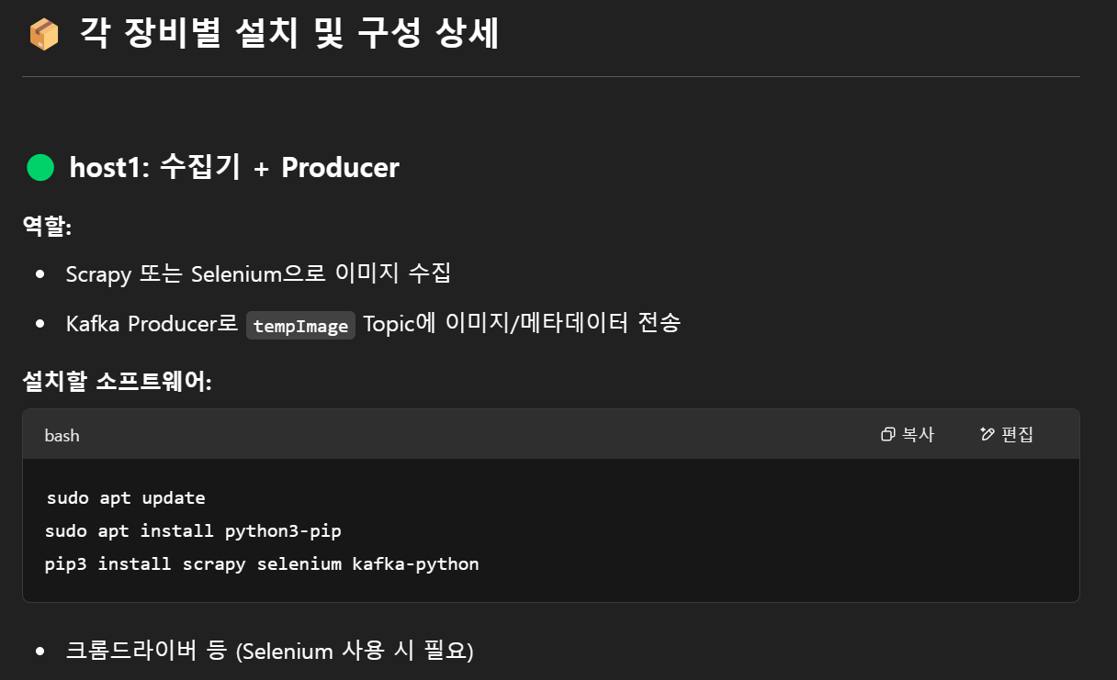

Slide 10
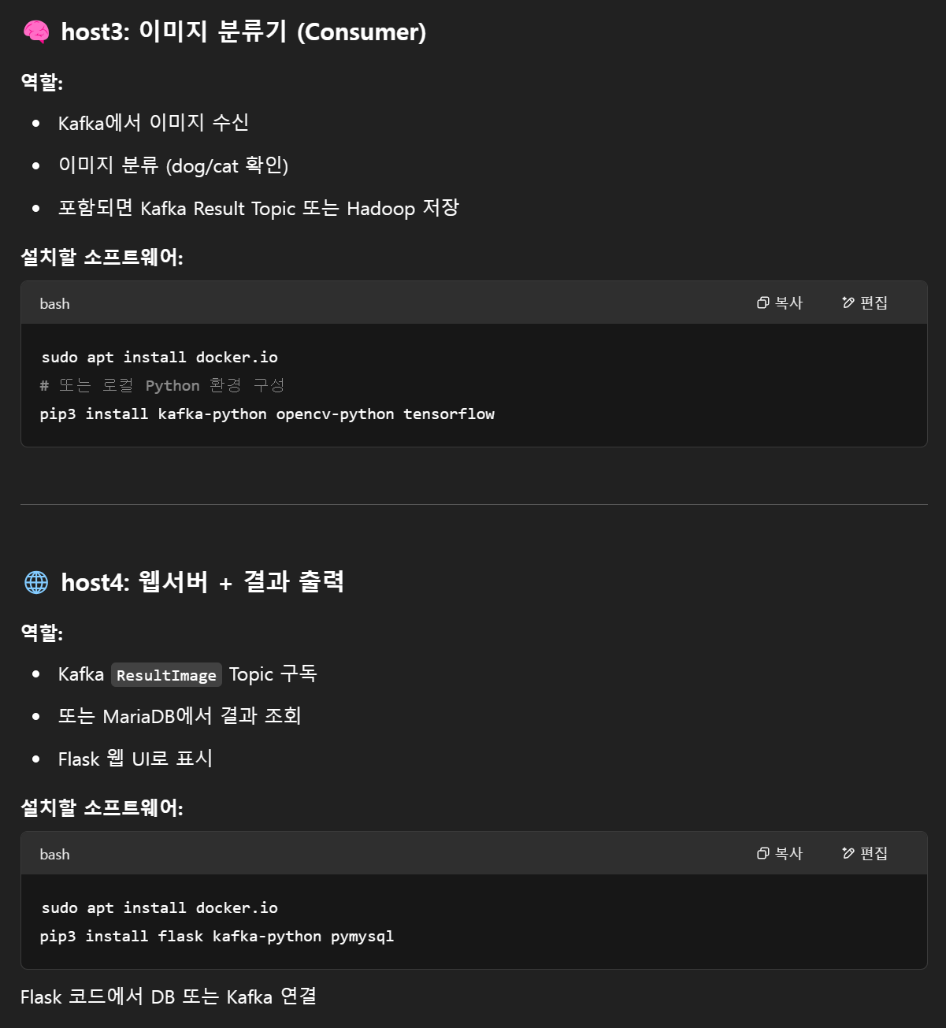
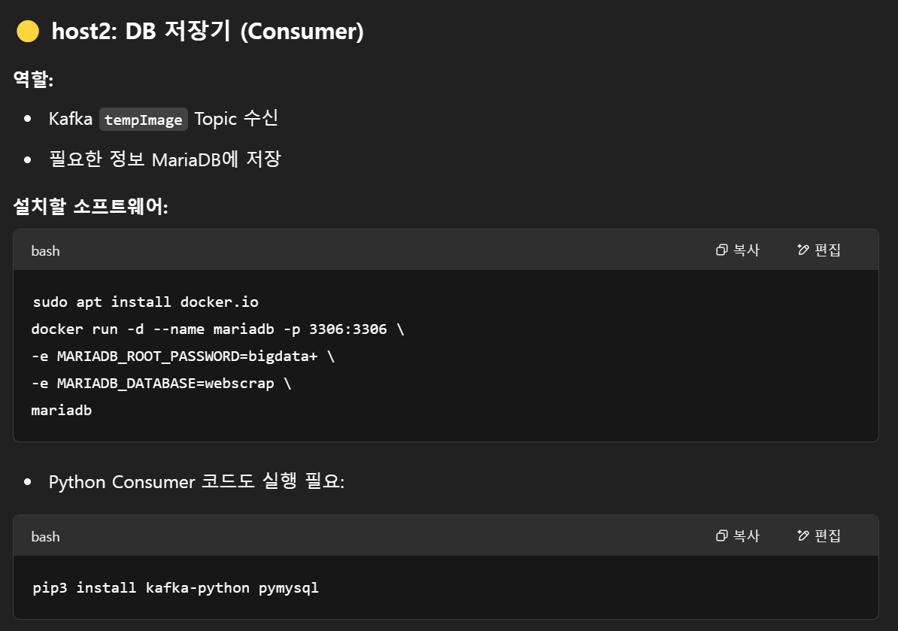

Slide 11
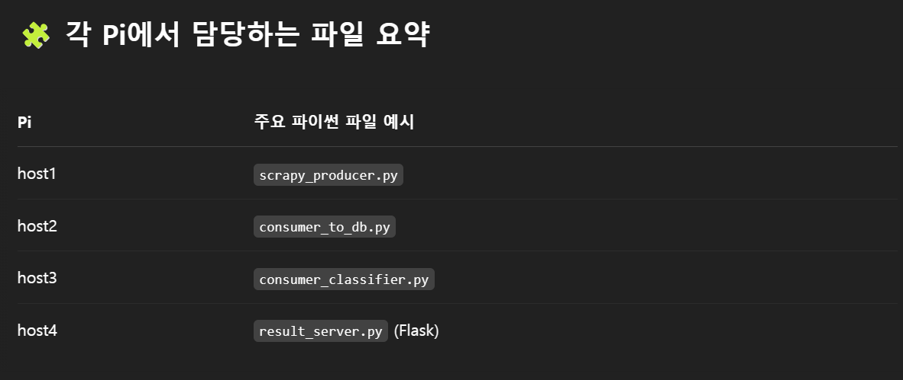
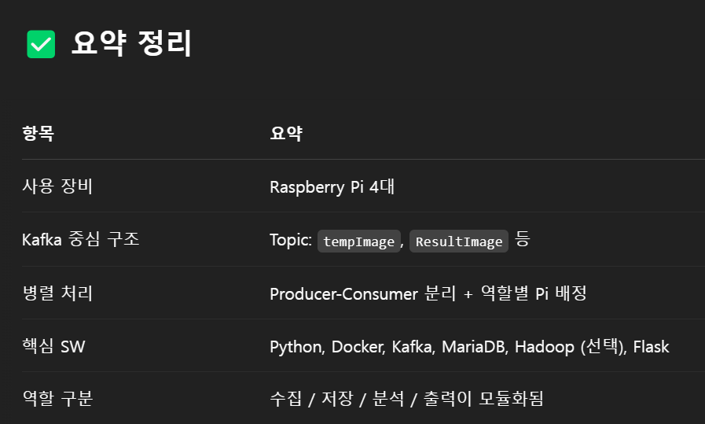
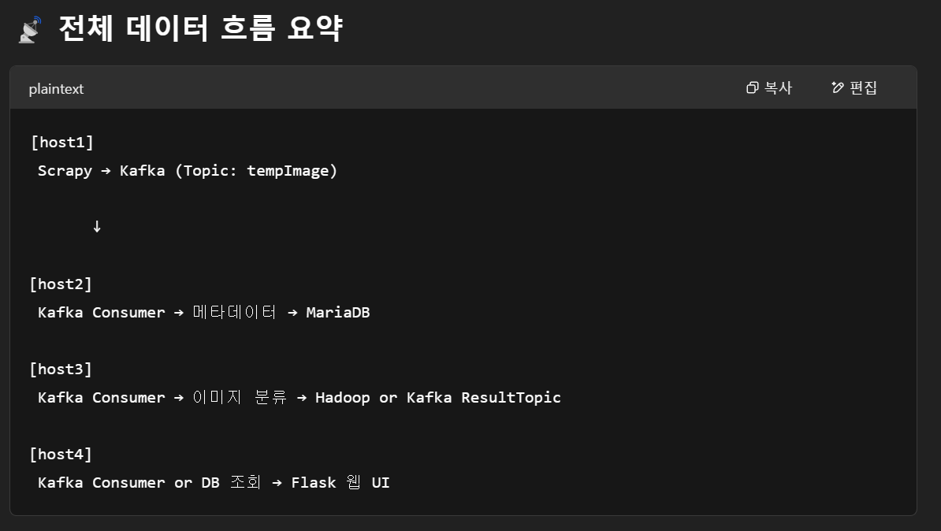

Slide 12
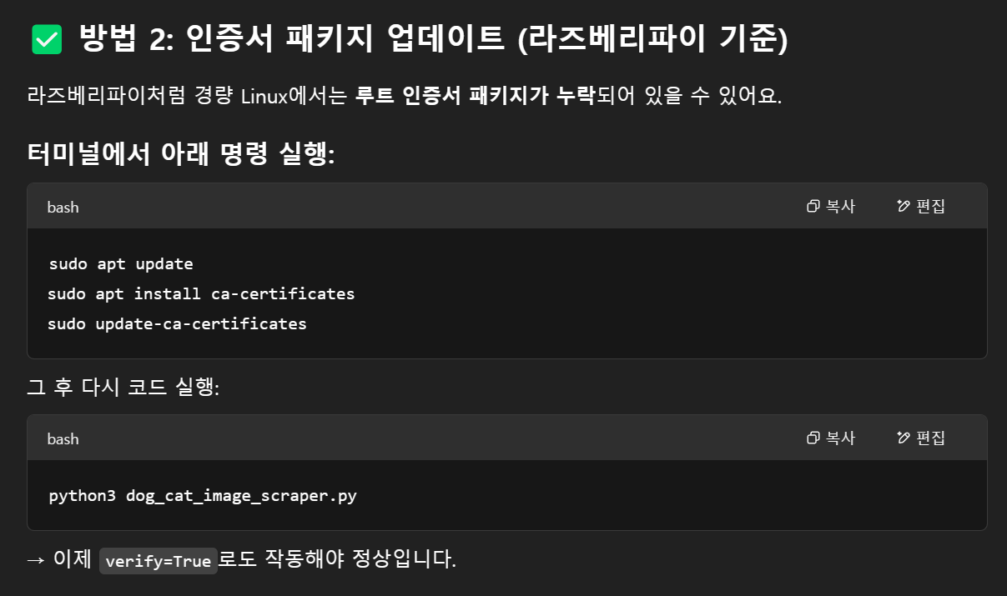

Slide 13
라즈베리파이용 경량화 AI
pip install tflite-runtime kafka-python pymysql pillow

